Slide 1
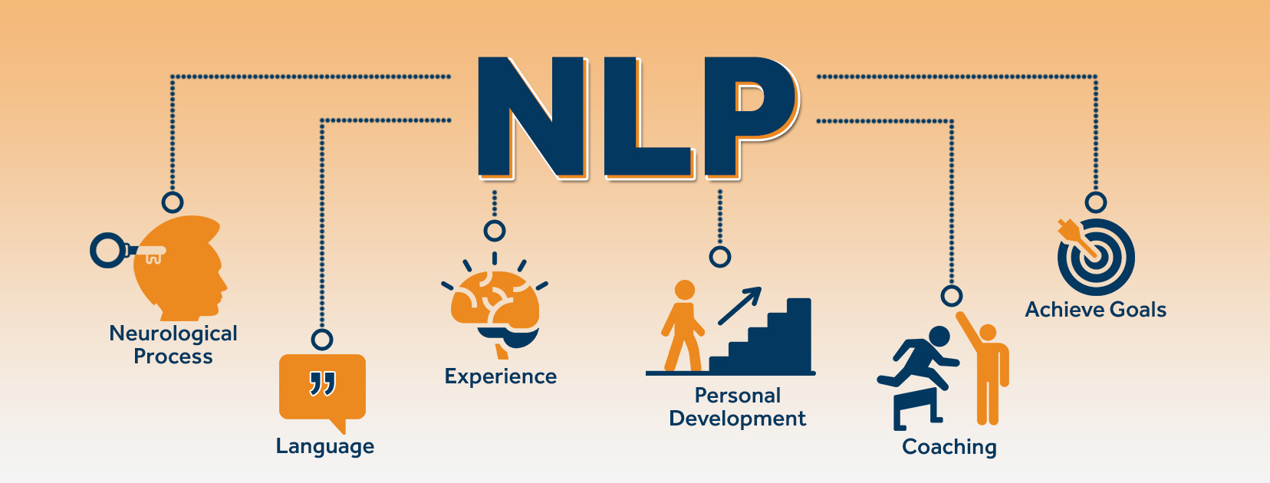
MALIGNANT COMMENTS CLASSIFICATION
USING NATURAL LANGUAGE PROCESSING
Project By -
Shivani Angadi
(Internship 14)

Slide 2
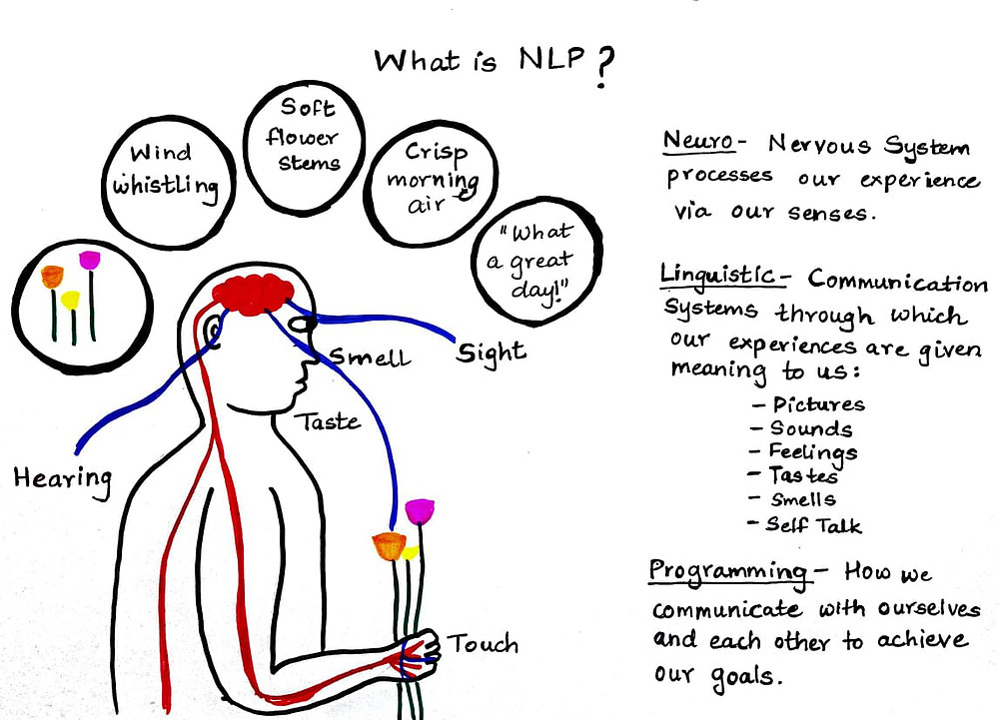

Slide 3
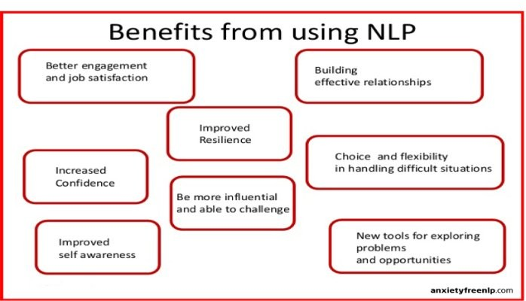

Slide 4
Project Description
Expression of opinions has become trouble-free across the internet because of escalation of social media platforms which has also resulted in creating hate all around making these platforms undesirable for the users.
Since spreading negativity over the internet is one of the major concerns of today, models lack in detecting hatred online.
Online hate can to severely dangerous and harmful to one’s life as it contains various content of abuse, bully, threat, etc.
Social Media has become very prone to such toxic human behaviours.

Slide 5
Data set is received in the form of two files i.e. train data and test data.
Train data set comprises of 159571 rows and 8 columns comprising of 6 target variables containing different types of malignant data.
Test data has 153164 rows and 2 columns.
The training is performed on the train data set and then the best trained model is used for the detection of malignant content in the test data set.

Slide 6
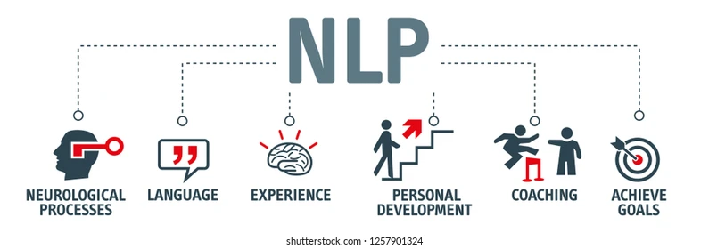

Slide 7
Business Goal
The business goal is to build a paradigm of online hate and abusive comment classifier that can be used to separate out the threat and abusive comments from the texts .
Malignant comment classifier model will act as a big help for the the social media platforms to control and restrict the negativity, cyberbully and hatred spreading across the internet.
Hence, this will become a big act for us to spread positively and good vibes all around on the internet making the customers feel inviting to social media platforms.

Slide 8
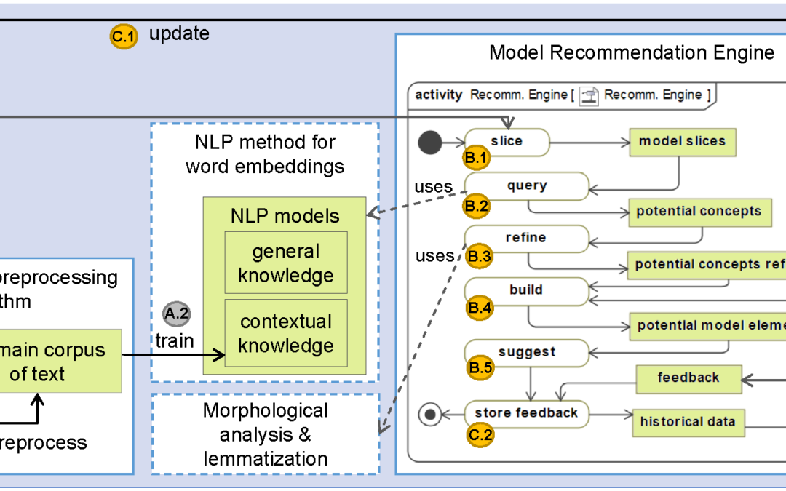
NLP Architecture

Slide 9
Research and Solution
Researching on the domain knowledge of the subject, reached to the solution of first performing feature engineering and pre-processing the redundancy of raw data which makes it suitable for training purpose.
After getting rid of the unwanted text, all the text language were converted to vectors using TF-IDF which will act as an input to different ML algorithms.
Since we have 6 different target variables, these target variables are treated as one label using “OneVsRest” function which can be further passed as an output to the ML model.
Once all these steps are done, various ML algorithms are trained on the data.

Slide 10
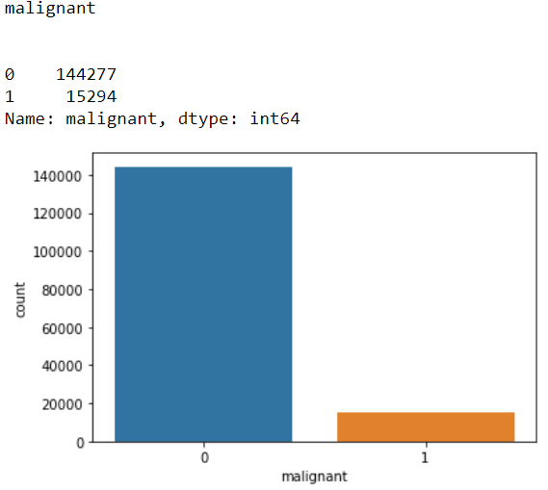
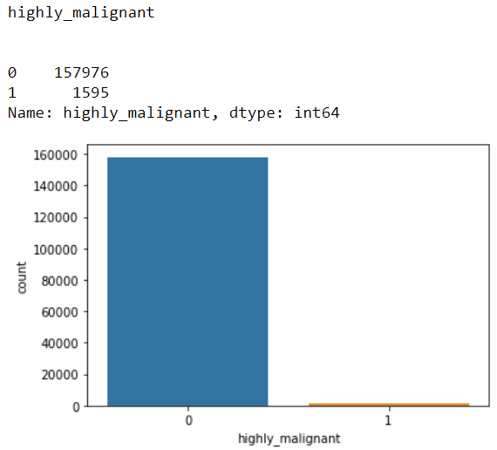
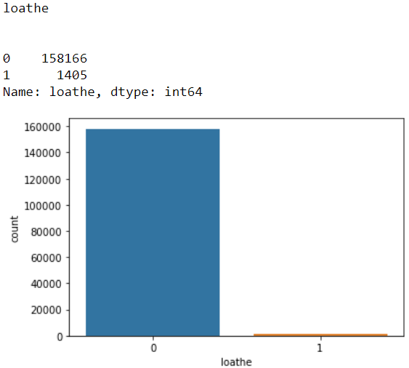
Data Distribution of Target Variables

Slide 11
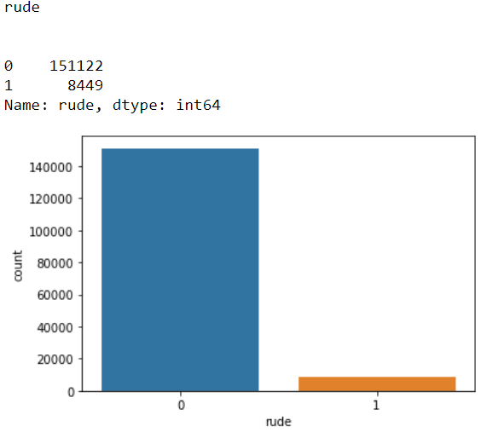
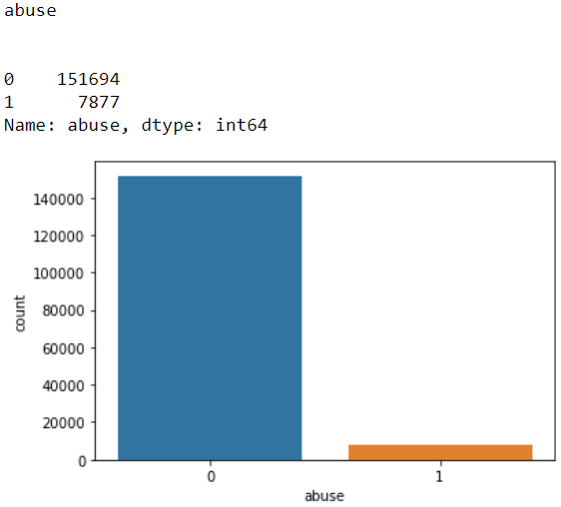
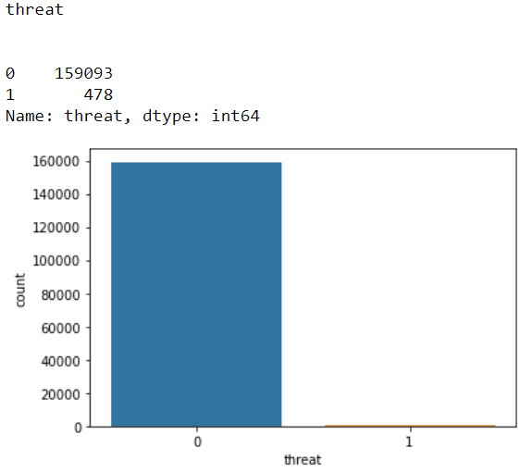

Slide 12
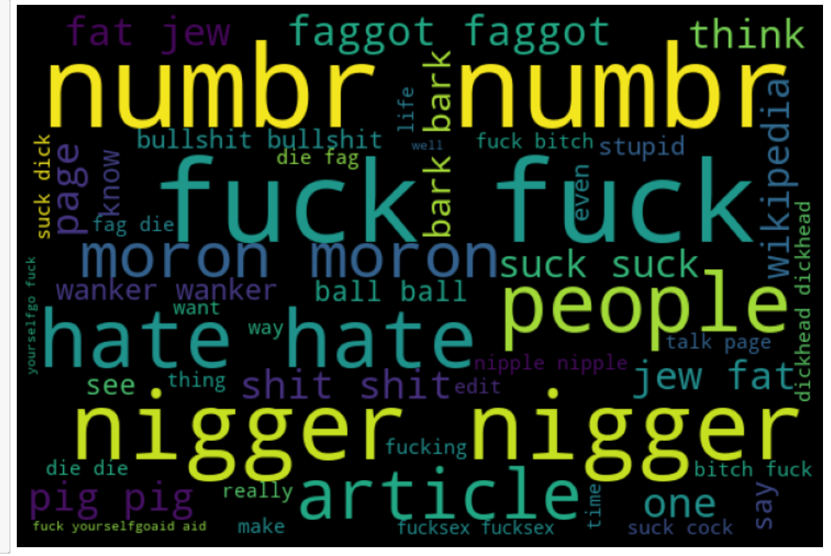
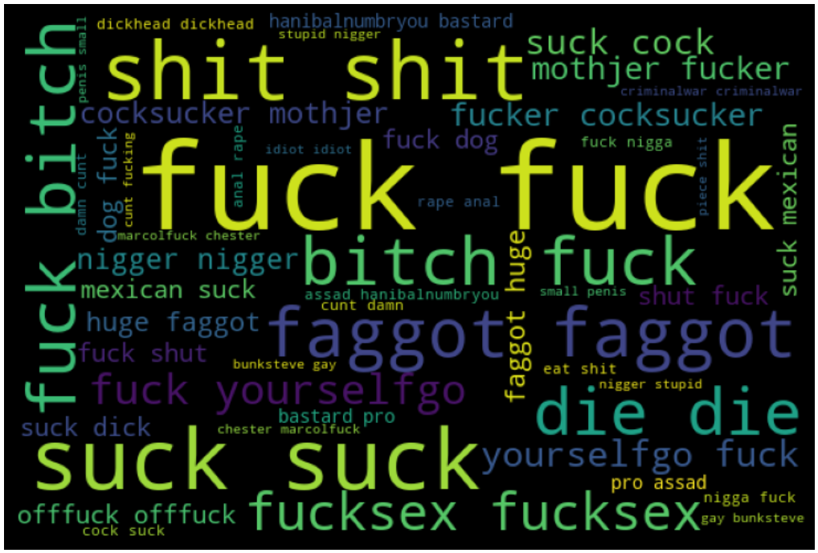
Representation of Most Occuring Words in different Target Variables
Malignant
Highly Malignant

Slide 13
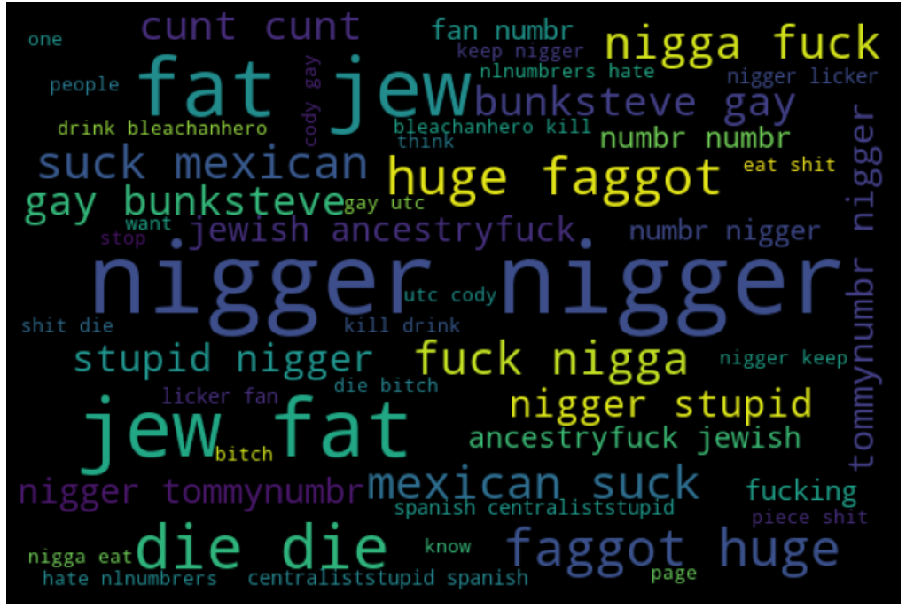
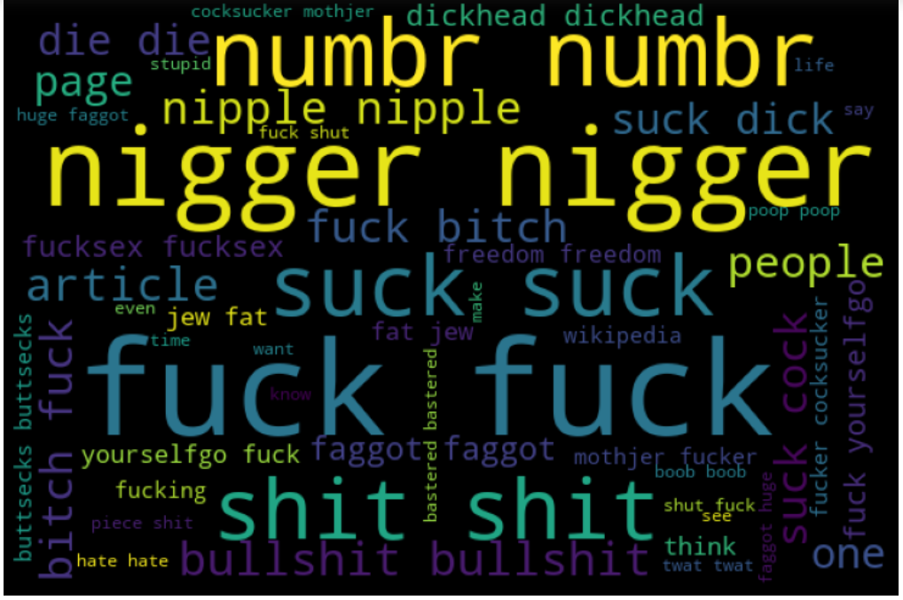
Loathe
Rude

Slide 14
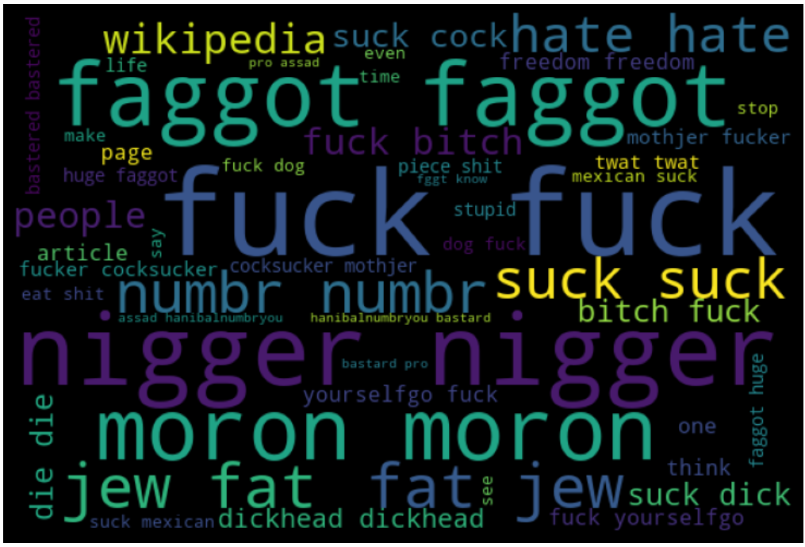
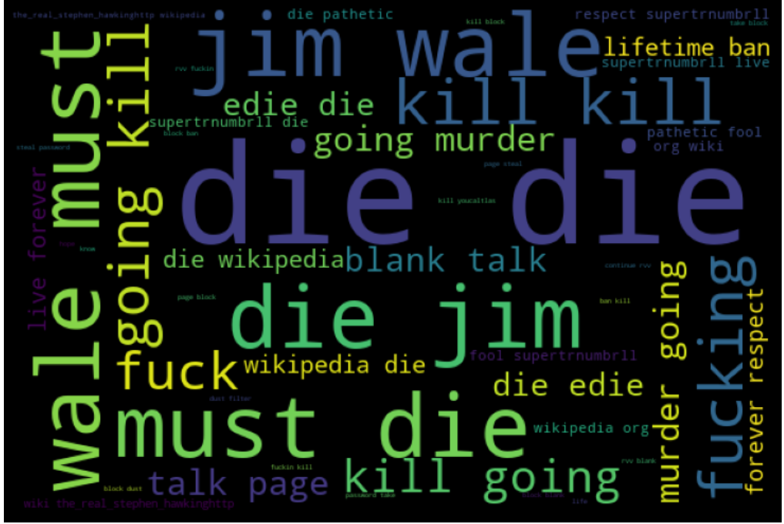
Abuse
Threat

Slide 15
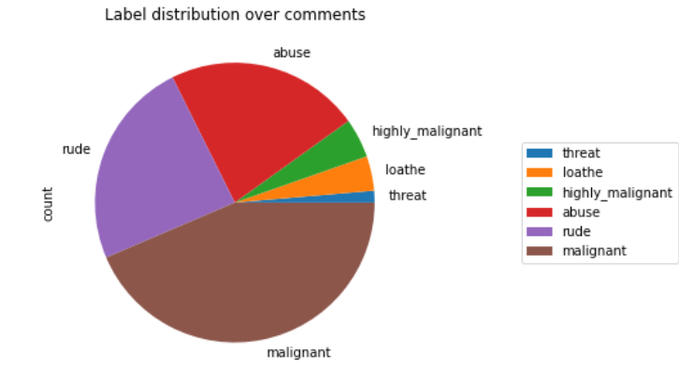
Combined Distribution of Target Variables

Slide 16
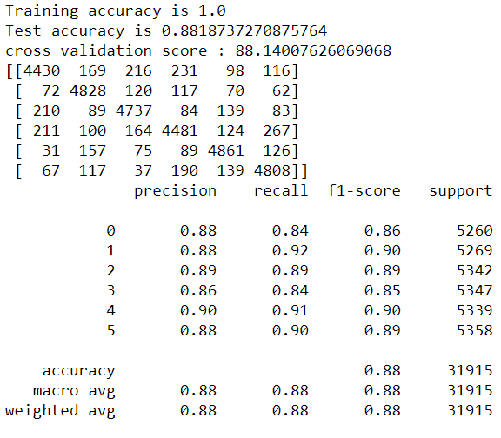
Accuracy of Best Model
Random Forest Classifier

Slide 17
Thank You..!

